Slide 1
MARKETING
LATEST TECHNIQUE OF BRANDING & MARKETING TODAY

Slide 2
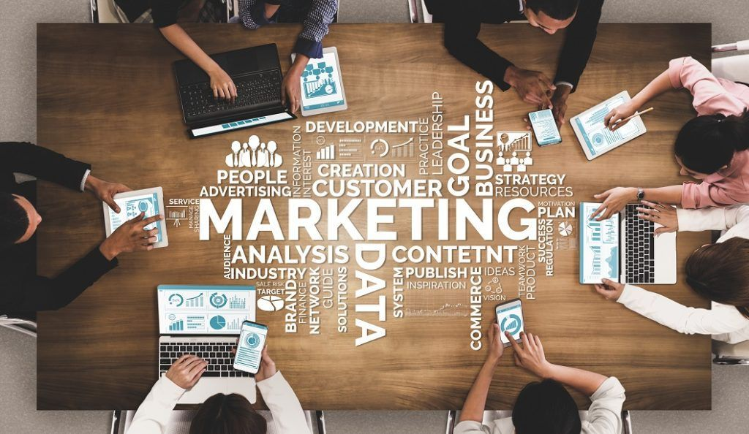
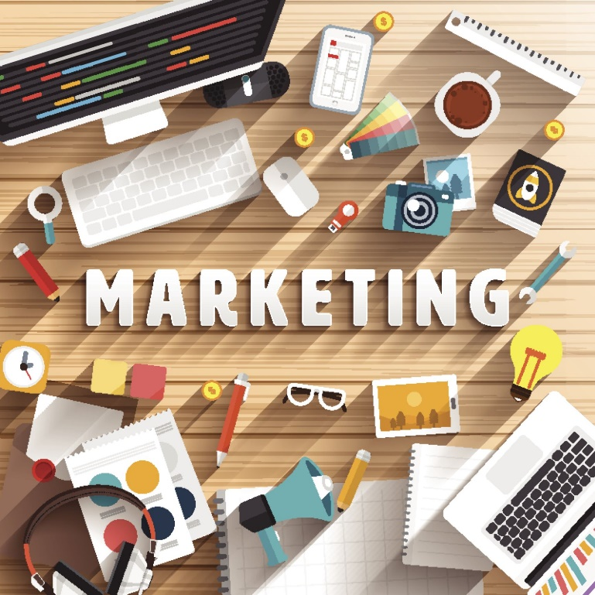
WHAT IS MARKETING
The action or business of promoting and selling products or services, including market research and advertising.
Marketing is the process of exploring, creating, and delivering value to meet the needs of a target market audience in terms of goods and services;

Slide 3




MAJOR TYPES OF MARKETING
There are 2 types of marketing:
TRADITIONAL MARKETING
Print Media i.e Flyers, Banners, Posters,
Outdoor activities
DIGITAL MARKETING

Slide 4
TYPES OF MARKETING
Digital marketing
Outbound marketing
Inbound marketing
Organic marketing
Outreach marketing
Guerilla marketing
Word of mouth marketing
Referral marketing
Acquisition marketing
Retention marketing
Behavioral marketing
Nostalgia marketing
Neuromarketing
Emotional marketing
Public relations
Relationship marketing
Voice marketing
Partnership marketing
User-generated marketing
Seasonal marketing
Stealth marketing
B2C
B2B
Telemarketing
Cause marketing
Event marketing
Global marketing
Conversational marketing
Product marketing
Account-based marketing

Slide 5
B2B & B2C MARKETING
B2B stands for Business to Business. B2B ecommerce utilises online platforms to sell products or services to other businesses
B2C stands for Business to Consumer. B2C ecommerce targets personal consumers.

Slide 6

PRINCIPLES OF MARKETING
These seven are 7 princinples of Marketing:
Product
Price
Promotion
Place
Packaging
Positioning
People.

Slide 7
WHAT IS THE DIFFERENCE BETWEEN MARKETING AND ADVERTISING?
Marketing is the process of identifying customer needs and determining how best to meet those needs.
Advertising is the exercise of promoting a company and its products or services through paid channels.

Slide 8
WHAT IS THE MARKETING PLAN FOR ANY BUSINESS DEVELOPMENT
A marketing plan is the first step in creating a successful marketing program for your your new business. Fortunately, it doesn’t have to be complicated in order to work. Here are the ten basic components of a marketing plan.
You are starting a new company/venture and now you’re thinking about developing a marketing program, you need to begin with a marketing plan, so here is the plan based on 10 components.

Slide 9

MARKETING PLAN
Marketing Research
Target Market
Product
Competition
Mission Statement
Market Strategy
Pricing, Positioning, Branding
Budget
Marketing Goals
Monitoring Results

Slide 10
1. MARKETING RESEARCH
Market research is the process of determining the viability of a new service or product through research conducted directly with potential customers.
Market research allows a company to discover the target market and get opinions and other feedback from consumers about their interest in the product or service.

Slide 11
MARKETING RESEARCH PRCOESS
8 Stages or Steps Involved in Marketing Research Process
Identification and Defining the Problem
Statement of Research Objectives
Market dynamics, patterns including seasonality
Customers – demographics, market segment, target markets, needs, buying decisions
Product – what’s out there now, what’s the competition offering
Current sales in the industry
Benchmarks in the industry
Suppliers – vendors that you will need to rely on

Slide 12
2. TARGET MARKET
Target marketing is a strategy that focuses your marketing on individuals and businesses who are most likely to buy from you
Find the target market i.e niche or major market for your product and describe them about your product/service.
Indenitifying the target market and needs by taking surveys, sample products, Localities, financial Statements, Demograpics, Interests, age, genders, etc

Slide 13
3. PRODUCT OR SERVICE
Describe your product or service.
How does your product relate to the market?
What does your market need?
what do they currently use?
what do they need above and beyond current use?

Slide 14
4. COMPETITION
Describe your competition.
Develop your USP “unique selling proposition.”
What makes you stand apart from your competition?
What is your competition doing about branding?

Slide 15
5. MISSION STATEMENT
Write a few sentences that state:
“Key market” – who you’re selling to
“Contribution” – what you’re selling
“Distinction” – your unique selling proposition

Slide 16
6. MARKETING STRATEGIES
Write down the Marketing and Promotional strategies that you want to use or at least consider using. Strategies to consider:
Networking – go where your market is
Direct marketing – sales letters, brochures, flyers
Advertising – print media, directories
Training programs – to increase awareness
Write articles, give advice, become known as an expert
Direct/personal selling
Publicity/press releases
Trade shows
Web site
Digital Marketing

Slide 17
7. PRICING, POSITIONING & BRANDING
PRICING: From the information you’ve collected, establish strategies for determining the price of your product?
POSITIONING: Where your product will be positioned in the market?
BRANDING: How you will achieve brand awareness?

Slide 18
8. BUDGET
Make a Budget for your Company to invest in.
What strategies can you afford?
What can you do in house, what do you need to outsource.

Slide 19
9. MARKETING GOALS
Establish quantifiable marketing goals.
This means goals that you can turn into numbers.
For instance, your goals might be to gain at least 30 new clients or to sell 10 products per week, or to increase your income by 30% this year.
Your goals might include sales, profits, or customer’s satisfaction.
Setup a target for sales to make your business profitable and can gain higher ROI (Return Over Investment).

Slide 20
10. MONITORING RESULTS
Test and analyze. Identify the strategies that are working.
Survey customers
Track sales, leads, visitors to your web site, percent of sales to impressions
By researching your markets, your competition, and determining your unique positioning, you are in a much better position to promote and sell your product or service. By establishing goals for your marketing campaign, you can better understand whether or not your efforts are generating results through ongoing review and evaluation of results.

Slide 21
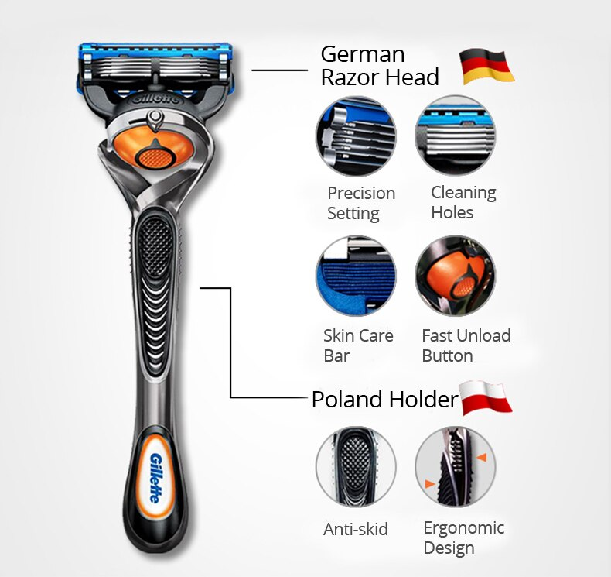
CASE STUDY #1
Gillette launched an amazing Razor with a new feature of opening blades by a single button after shave, which helped to washout all the hair when a user put the razor under a flowing water tap.
This product was the best selling in USA, Gillette company planned to relaunch it in India because of same number of population but the result didn’t go in the favor of the company and Failed to succeed.
What is the reason behind that Failure?

Slide 22
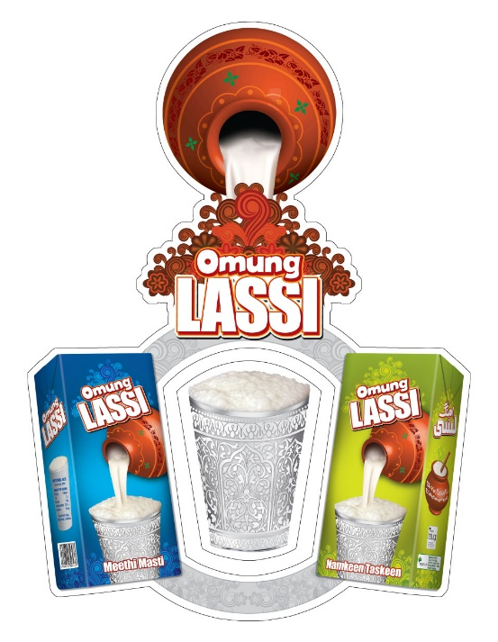
CASE STUDY #2
Engro Foods launches a Lassi Brand named Omung Lassi in mid of June 2012.
They are very confident about the success of their brand because of the popularity and tradition of Lassi in Pakistan. Also, they didn’t have any competitor in this Industry of Lassi in Tetra pak.
They have a very good packaging with 2 variants of Namkeen Taskeen (Salted Lassi) and Meethi Masti (Sweet Lassi).
They are targeting the market segment of Teenagers and Youngsters, but unfortunately Omung Lassi is nowhere in the Market Cap.
What could be the reason of the Brand Failure?

Slide 23
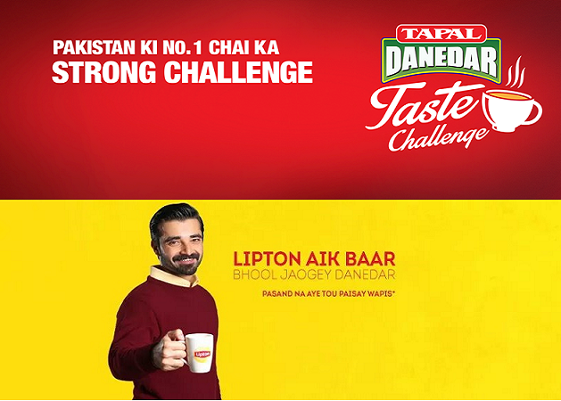
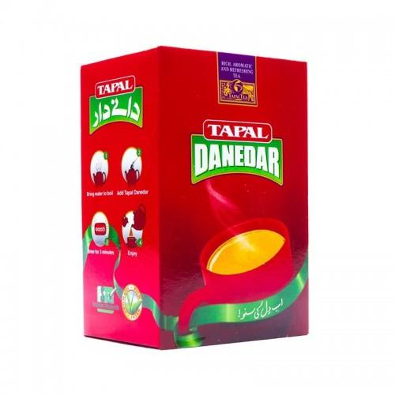
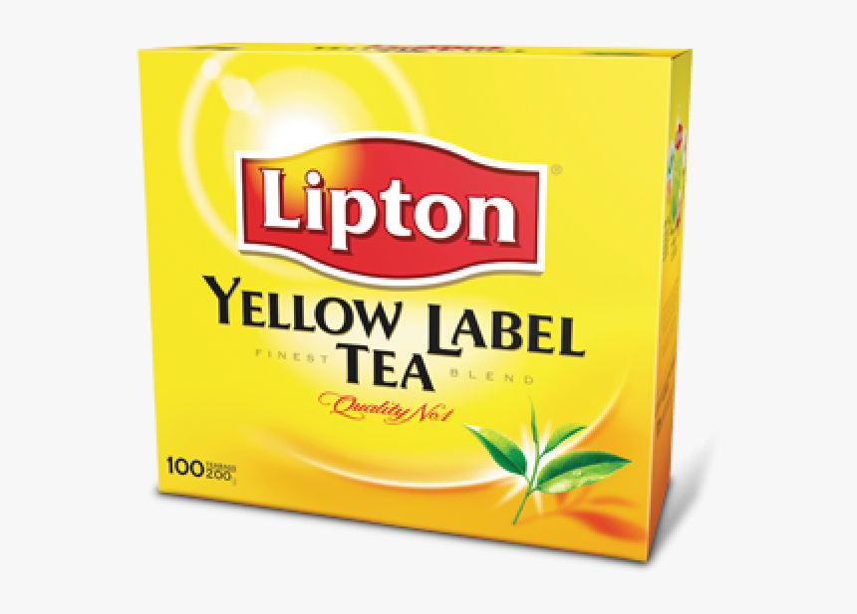
CASE STUDY #3
In Pakistan, Mostly 2 Famous Brands of Tea i.e Tapal and Lipton, are running massive and making a good business.
Lipton was found in 1893, Thomas Lipton. Tapal was found in 1979 by Aftab Tapal.
Because of the same Product and Market Cap, what are the USPs of thes 2 different Brands?
Which Brand has more consumer among them?

